Slide 2
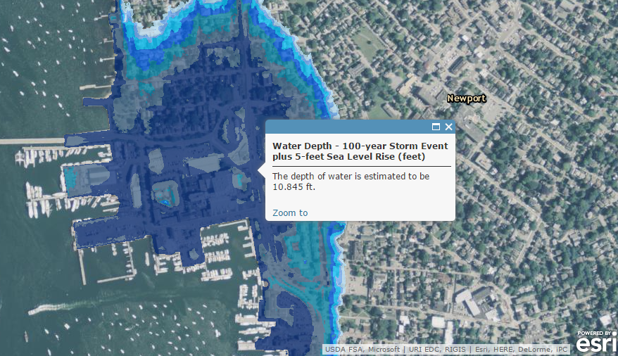
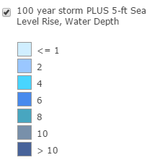
Newport – 100-year Storm with 5 feet Sea Level Rise
*Marker shows water depth at Newport Marriott

Slide 3
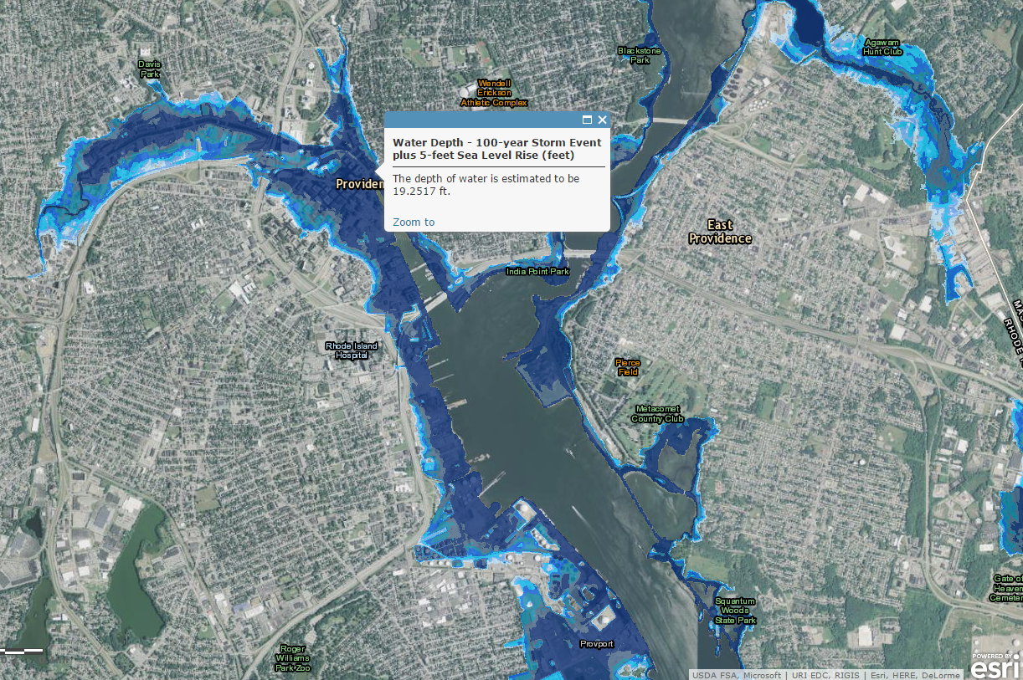
Providence – 100-year Storm with 5 feet Sea Level Rise
*Marker shows point near Memorial Park

Slide 4
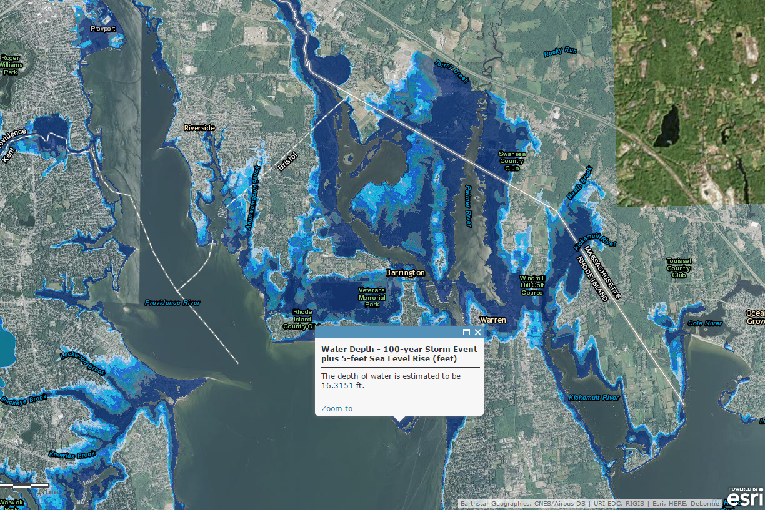
Barrington and Warren – 100-year Storm with 5 feet Sea Level Rise
*Marker shows one of the greatest water depths in the area

